Slide 1

Intellicator
C++ Qt Monte Carlo Simulation application that estimates a stock's price based on the historical average rate of return and volatility (std dev of returns) and runs a number (n) of simulations to simulate possible paths of stock price movements.

Slide 2

Build
Microsoft Visual Studio Community 2022 (64-bit)
Qt Visual Studio Tools - 3.0.2
Qt 6.1.1 binaries compiled for MSVC 2019

Slide 3

Monte Carlo Simulations
August 1913 was a day at the Monte Carlo Casino the roulette wheel landing on black 26 times in a row 1 in ~64M chance
Gambler’s Fallacy – Each spin was an independent event – therefore the chance for red or black were always 50%
What Monte Carlo Simulations tries to benefit from the law of big numbers and gets closer to the mean
Monte Carlo simulation is a computational technique used to estimate the probability distribution of outcomes by generating a large number of random samples

Slide 4

Basic Stock Predictions
Originally goal was to see how current events affected the stock prices
Economy – long / short
Natural Disasters
Inflation/Recession
Researched lead to the Monte Carlo simulation. A mathematical technique that predicts possible outcomes of an uncertain event using past data to predict a range of random outcomes.

Slide 5
Break down of algorithm
double Simulator::simulateStockPrice(double S0, double mu, double sigma, double timeHorizon, std::mt19937& generator) const
{
std::normal_distribution<double> distribution(0, 1);
double price = S0;
for (double time = 0; time < timeHorizon; time += 1.0 / ONE_YEAR_TRADING_DAYS) {
the deterministic drift “avg return” term in the geometric Brownian motion model
price += mu * price * (1.0 / ONE_YEAR_TRADING_DAYS) +
introduces randomness into the simulation capturing unpredictable fluctuations in stock prices “volatility”
sigma * price * sqrt(1.0 / ONE_YEAR_TRADING_DAYS) * distribution(generator);
}
return price;
}
divides the time horizon into smaller intervals corresponding to trading days.

Slide 6
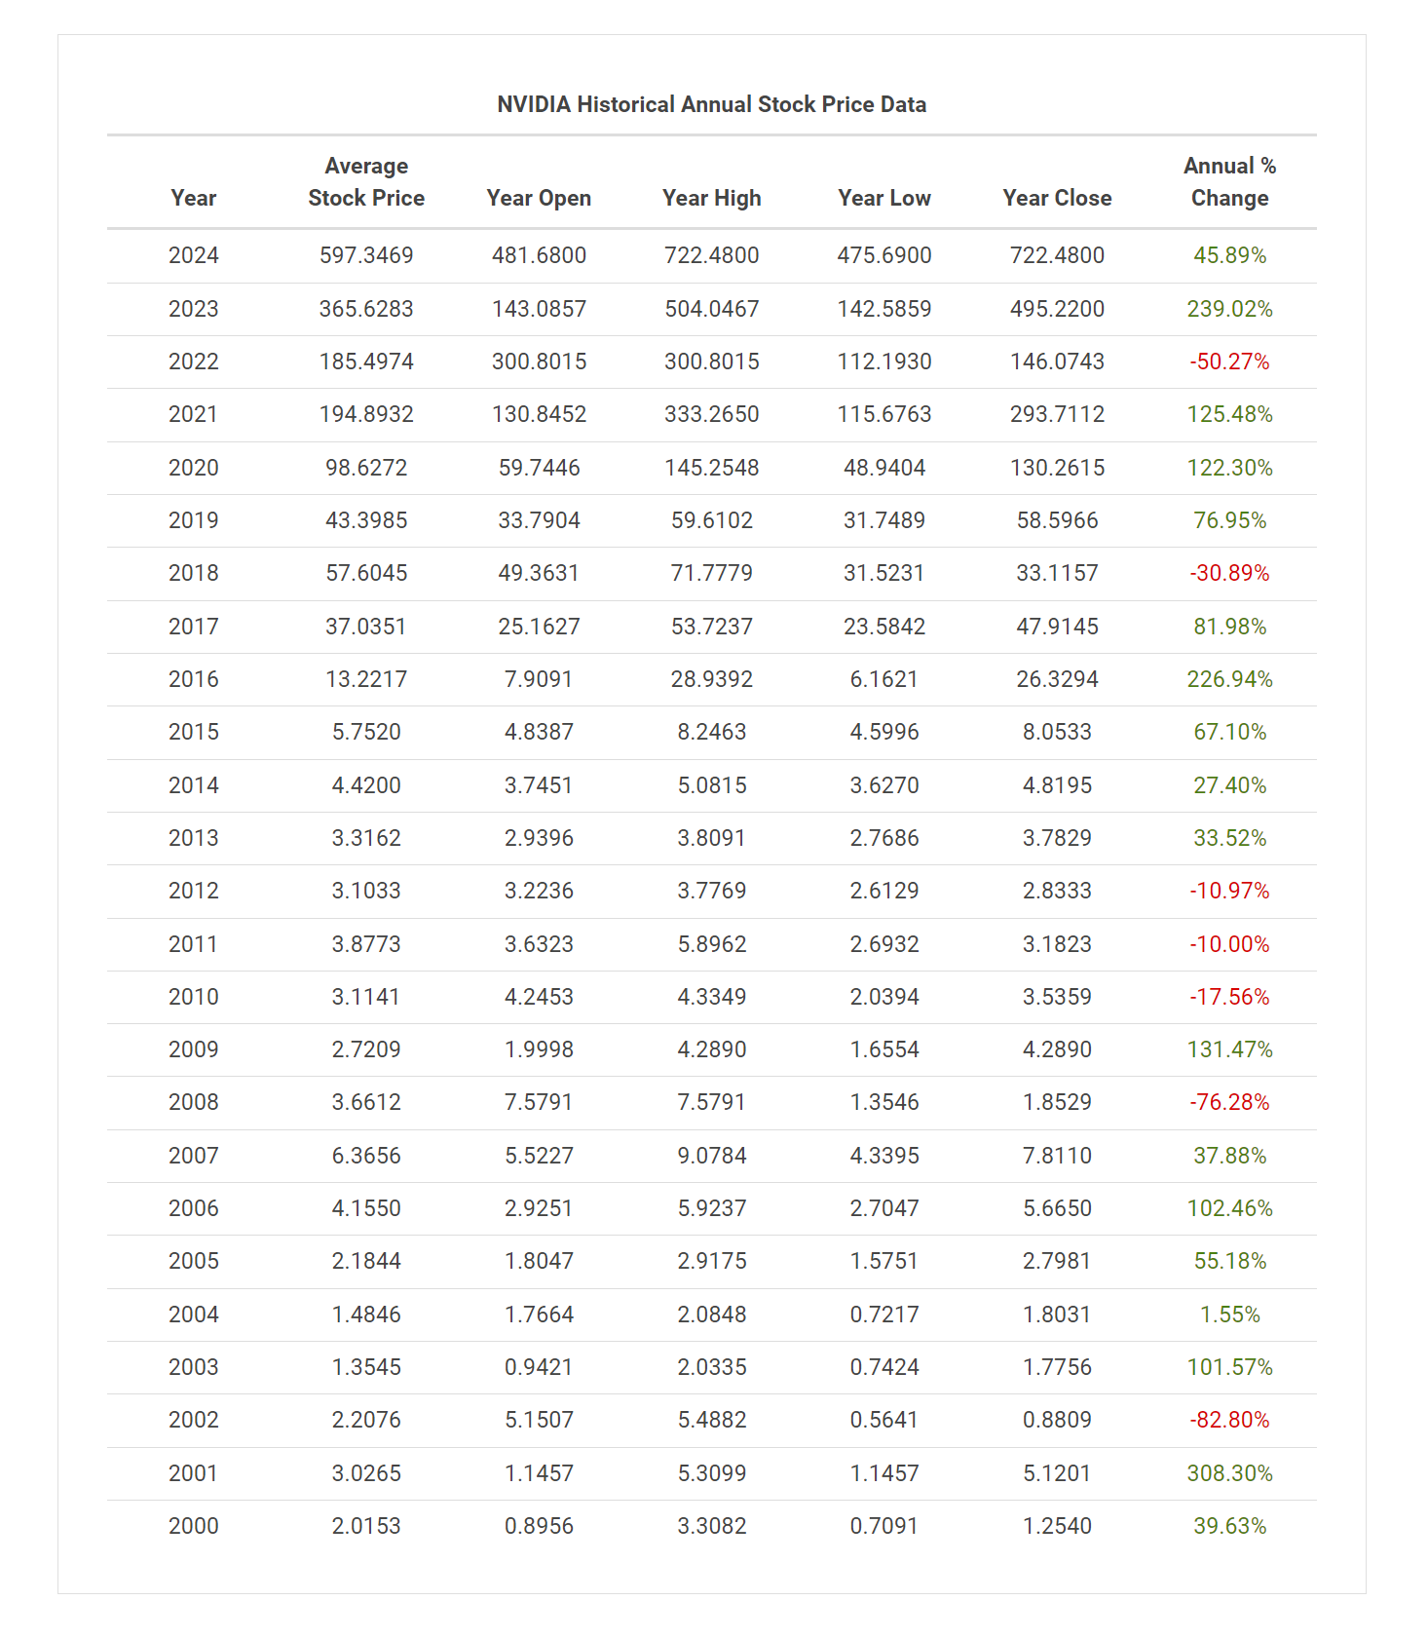
Nvidia’s – annualized return 35%
According to Kiplinger, Nvidia's stock has had an annualized total return of 35% over the past 20 years
Reference: https://www.macrotrends.net/stocks/charts/NVDA/nvidia/stock-price-history

Slide 7
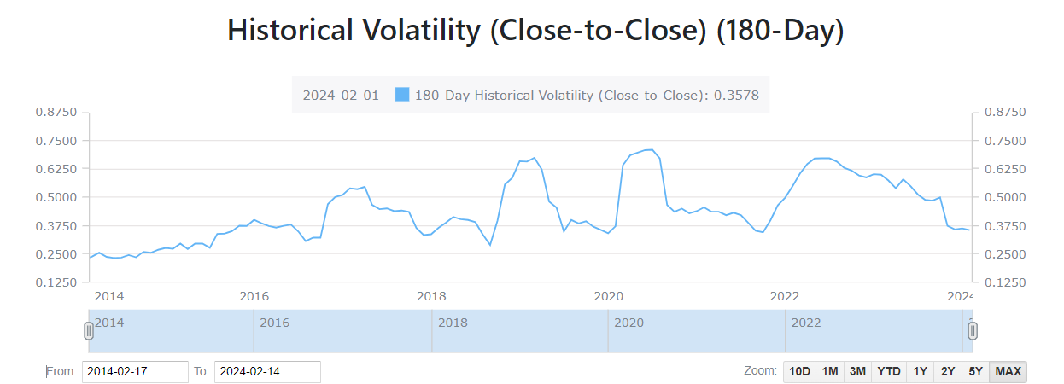
Nvidia’s - Historical Volatility 37%
Def: a statistical measure of how much a security's price deviates from its average over a period of time.
Reference: https://www.alphaquery.com/stock/NVDA/volatility-option-statistics/180-day/historical-volatility

Slide 8
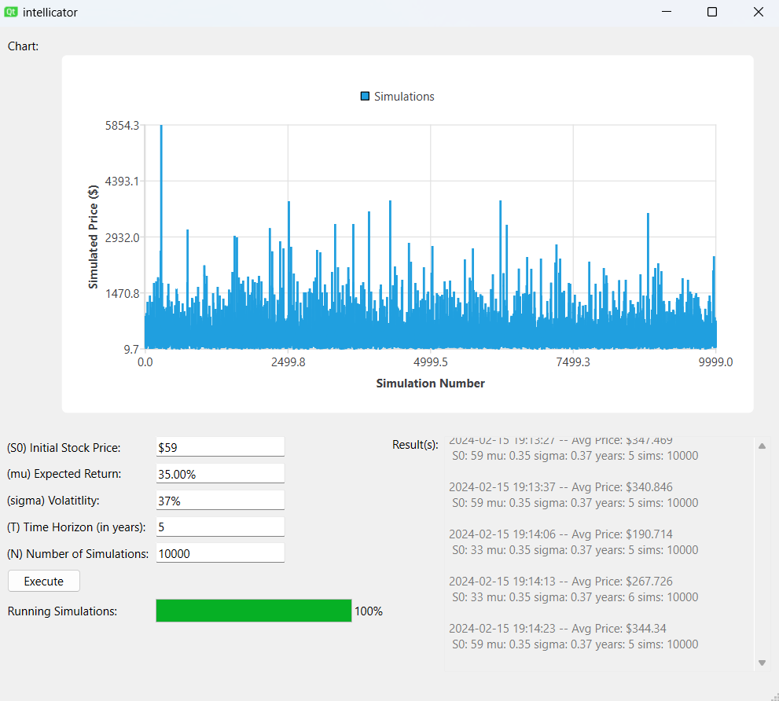
Demo

